Slide 1
EarnSync – Freelance Portal
Team Members:
Muhammad Bilal Khawar (22i-0786)
Saffi M. Hashir (22i-1293)
Hamza Ahmed Siddiqui (22i-1339)
Course: Software Engineering
Submitted to: Sir Basharat Hussain
Submission Date: 29th April 2024

Slide 2
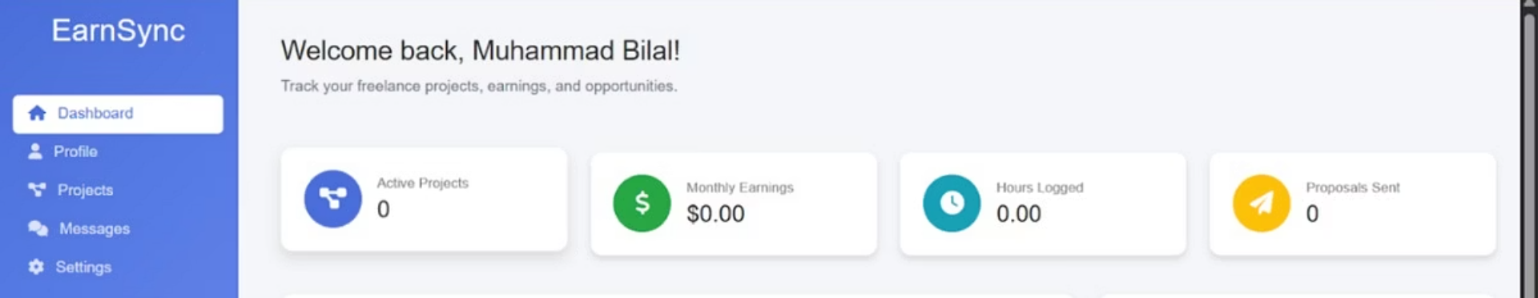
Project Introduction
What is EarnSync?
Why is it needed?
A centralized platform connecting freelancers and employers.
Streamlines project collaboration.
Ensures transparent milestone payments.
Facilitates dispute resolution effectively.

Slide 3
Functional Requirements
User Registration & Login
Job Posting & Application
Role-based access control for security
Create and apply to freelance jobs
Milestone Management & Payments
Chat System
Track progress with secure payments
Real-time messaging between users
Dispute Management
Admin Dashboards
Resolve conflicts transparently
Super Admin & Admin control panels

Slide 4
Non-Functional Requirements
Performance
Security
Supports 10,000 concurrent users
Data encrypted at rest and transit
Response time under 2 seconds
Multi-factor authentication implemented

Slide 5

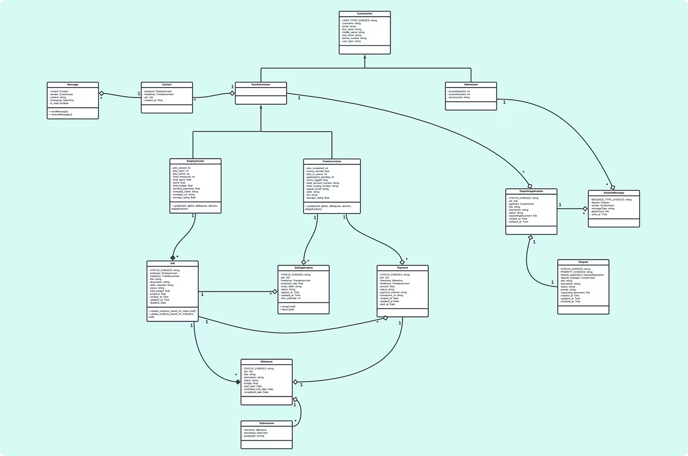
Class Diagram
Major classes define roles, jobs, milestones, disputes, and profiles

Slide 6
Architecture
Client Layer
Frontend Layer
User interface on web browsers
Handles presentation and business logic
Backend Layer
Database Layer
Processes requests, manages data
Stores persistent data securely

Slide 7

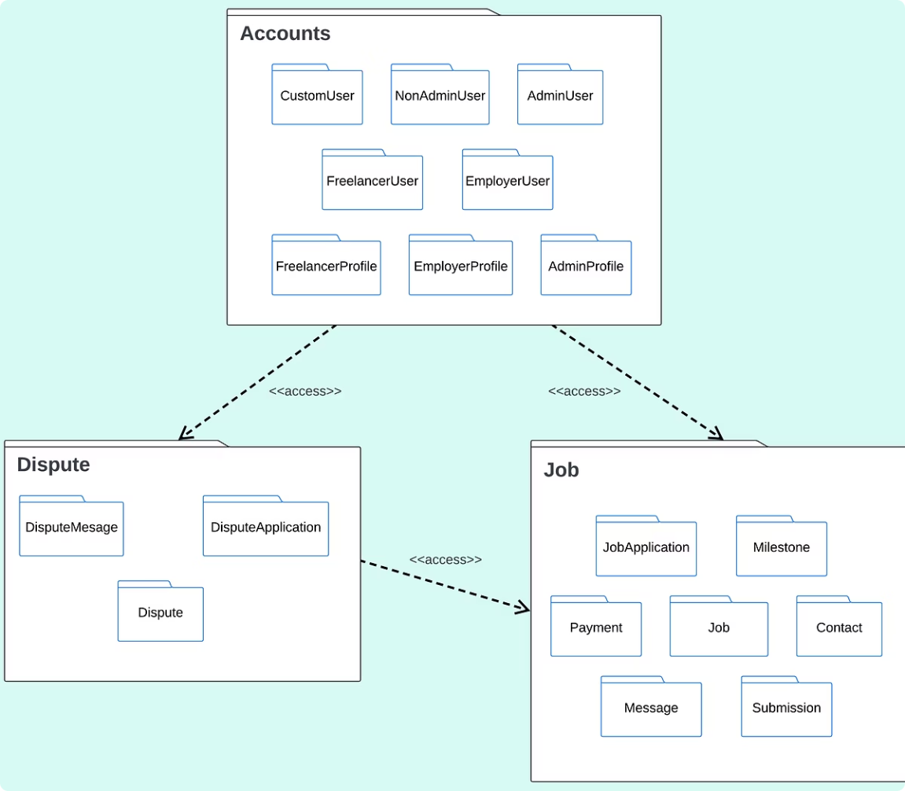
Package Diagram
Divides the system into Accounts, Job and Dispute packages.

Slide 8
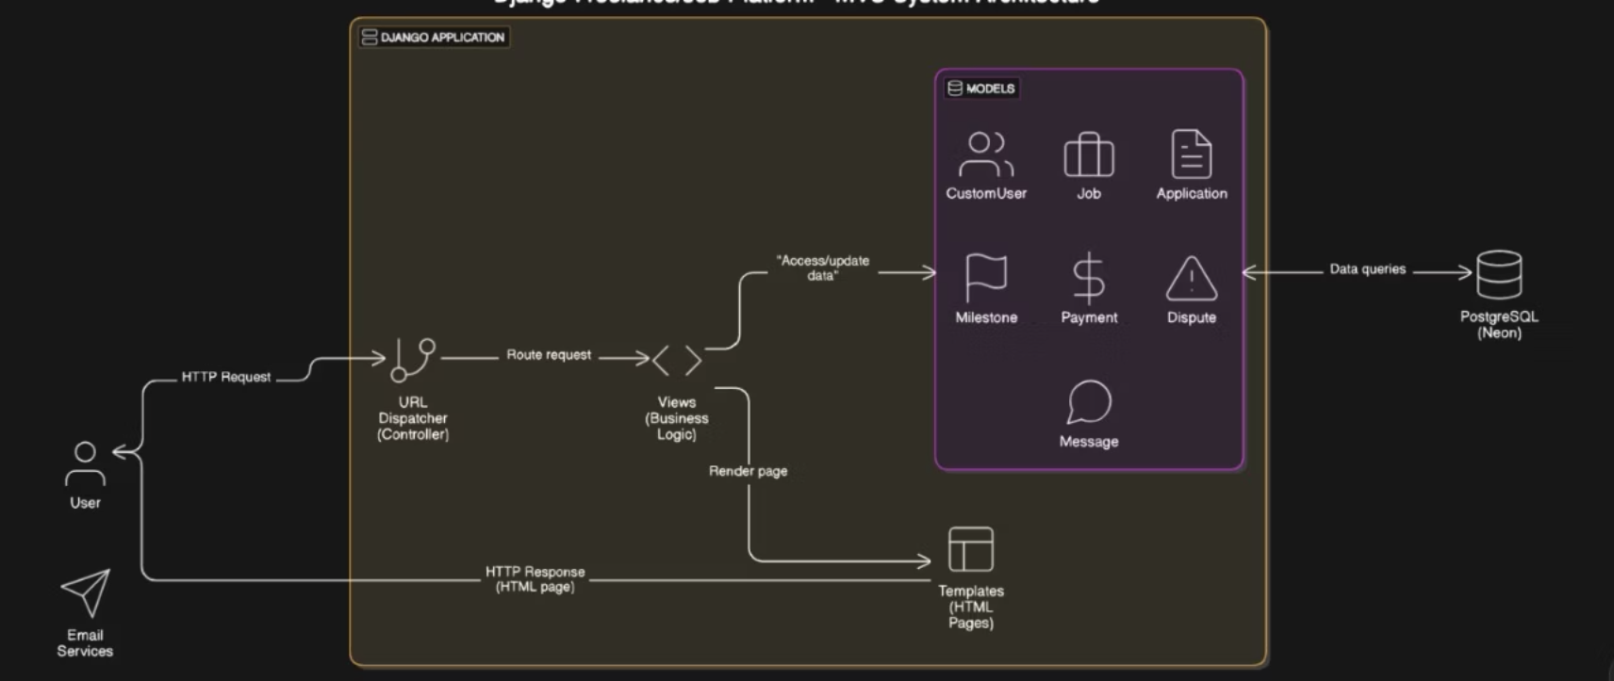
Architecture Diagram

Slide 9

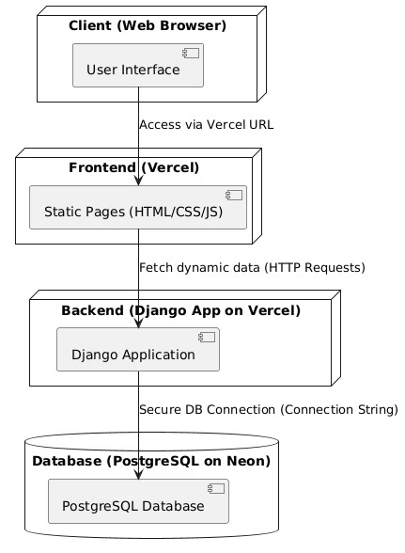
Deployment Diagram
Shows EarnSync deployed across Web Browser, Frontend Server, Backend Server, and Database.

Slide 10

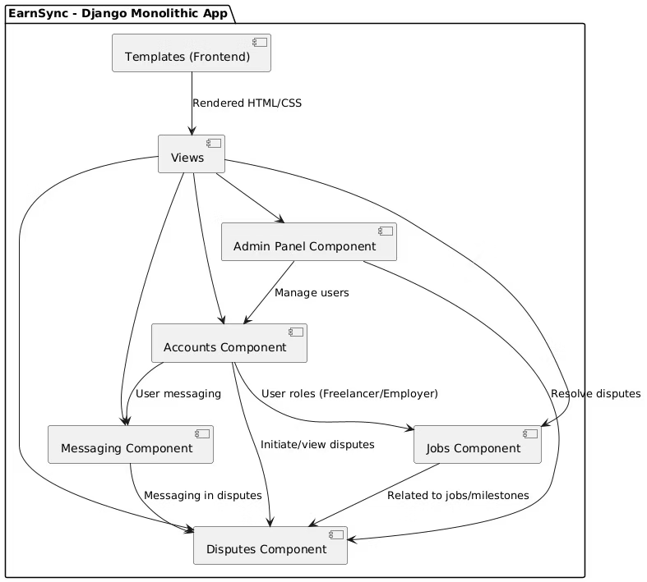
Component Diagram
Breaks the system into Accounts, Jobs, Admin Panel, Messaging, and Disputes components.

Slide 11
Work Breakdown Structure - Sprint 1
1.1 Sprint 1: User System and Homepage
1.1.1 User System (Frontend)
Freelancer Registration UI (US11)
Employer Registration UI (US12)
Login UI (US13)
1.1.2 User System (Backend)
Authentication APIs (US11, US12, US13)
User Management APIs (Profile Creation, Login Sessions)
1.1.3 Home Page (Frontend)
System Introduction Section``
Basic Navigation (Login/Register Links)

Slide 12
Work Breakdown Structure - Sprint 2
1.2 Sprint 2: Admin, Projects, Messages, Profiles
1.2.1 Admin Dashboard (Frontend)
1.2.3 Messages Page
Admin Control Panel UI
Send Messages - Backend (US02)
User Management Overview
View Messages - Backend (US03)
Chat System UI (US04)
1.2.2 Projects Page (Frontend)
Post Jobs Form (US01)
1.2.4 Profile Page (Frontend)
Apply for Jobs Interface (US09)
View Profile UI (US11, US12, US13)
View Job Listings (US10)
Edit Profile Form
Review Applications (US14, US15, US16)

Slide 13
Work Breakdown Structure - Sprint 3
1.3 Sprint 3: Backend for Projects, Messages, Profile, Payments, Disputes, Analytics
1.3.1 Projects Page (Backend)
Job Posting APIs (US01)
Job Application APIs (US09)
Job Listings and Status Management APIs (US10, US14, US15, US16)
1.3.2 Messages Page (Backend)
Send/Receive Message APIs (US02, US03)
Chat Management APIs (US04)
1.3.3 Profile Page (Backend)
Profile View/Edit APIs (US11, US12, US13)

Slide 14
Work Breakdown Structure - Sprint 3
1.3 Sprint 3: Backend for Projects, Messages, Profile, Payments, Disputes, Analytics
1.3.4 Payment System
1.3.5 Dispute System
Payment Initiation UI (US05)
Raise Dispute UI (US06)
Payment Confirmation Page (US17)
Dispute Communication Interface (US07)
Transaction History UI
Dispute History View (US08)
Payment Processing Logic (US05)
Dispute Management APIs (US06, US07, US08)
Payment Gateway Integration and Validations (US17)
1.3.6 View Analytics
Platform Activity Dashboard UI (US18)
Data Aggregation & Analytics APIs (US18)

Slide 15
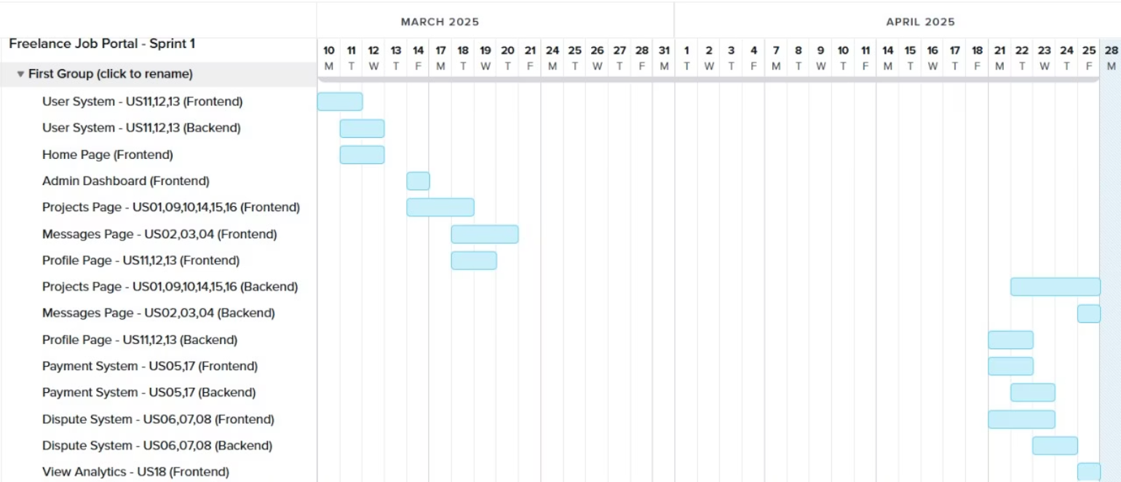
Gantt Chart

Slide 16
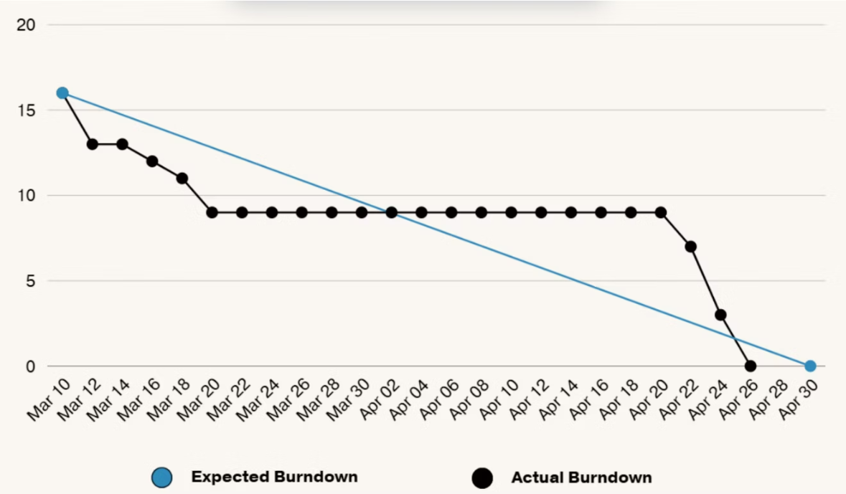
Burndown Chart

Slide 17
Sprint Planning
Sprint
Main Tasks
Assigned To
Sprint 1
Registration/Login UI, Home Page, Auth APIs
Bilal, Hashir, Hamza
Sprint 2
Admin Dashboard, Projects Page, Messages, Profiles
Hamza & Bilal
Sprint 3
Backend for Projects, Messaging, Profile, Payments, Disputes, Analytics
Hashir, Hamza, Bilal

Slide 18
Major User Stories
User Story ID
Priority
User Story
US01
High
As a Freelancer, I want to search and apply for jobs, so that I can find work opportunities that match my skills and earn income.
US02
High
As a Freelancer, I want to communicate with employers and admins, so that I can collaborate effectively and resolve any project-related queries or issues.
US14
High
As an Employer, I want to post a job, so that I can hire freelancers for specific tasks or projects.
US16
High
As an Employer, I want to create project milestones and release payments, so that I can manage progress and ensure timely payments.
US08
Medium
As an Admin, I want to intervene in disputes, so that I can mediate and ensure a fair resolution for both parties.

Slide 19
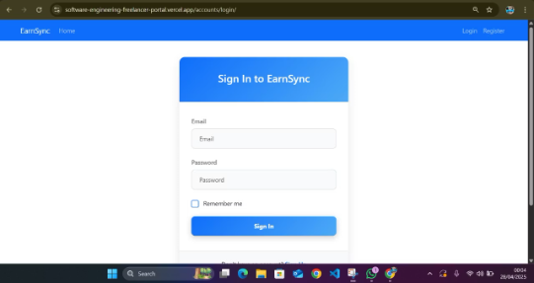
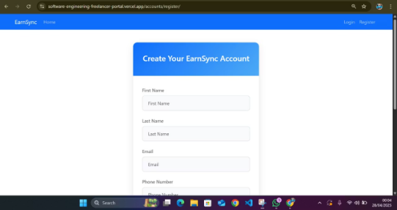
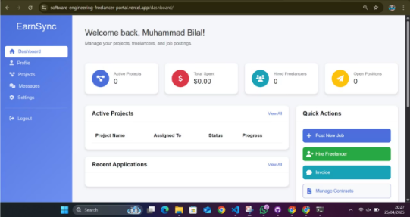
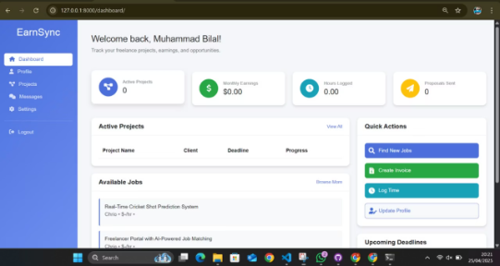
Implementation Screenshots
Login & Register
Register
Employer Dashboard
Freelancer Dashboard

Slide 20
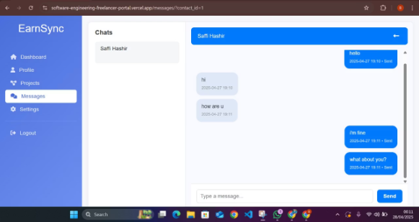
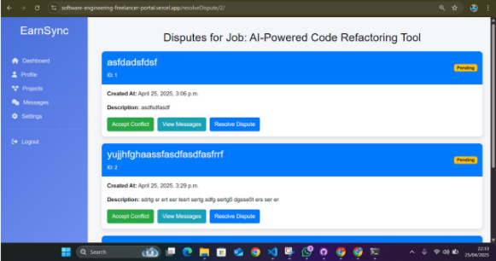
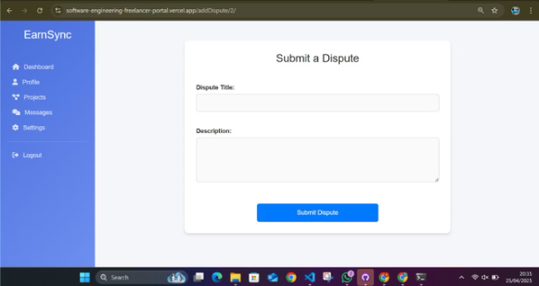
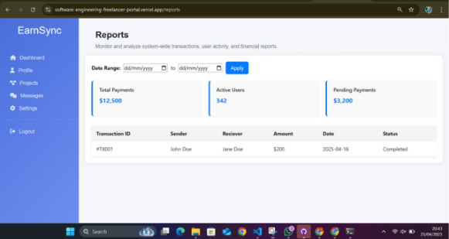
Implementation Screenshots
In-app Messaging
Dispute Resolution
Submit Disputes
Admin Analytics Panel

Slide 21
Blackbox Testing - Equivalence Class Partitioning
Test Case ID
Feature
Test Description
Input
Expected Output
Status
TC01
User Registration
Valid registration input for Employer
Email: bilal@gmail.com
Registration successful
Pass
Password: test123
Role: Employer
TC03
Login
Valid credentials
Email: bilal@gmail.com
Redirect to dashboard
Pass
Password: test123

Slide 22
Blackbox Testing - Boundary Value Analysis
Test Case ID
Feature
Test Description
Input
Expected Output
Status
TC11
Password Validation
Minimum length (boundary)
Password: 6 chars
Accepted
Pass
TC13
Job Title Length
Maximum allowed characters (boundary)
Title: 255 chars
Accepted
Pass

Slide 23
White Box Testing
Tools Used:
pytest-django for unit testing
coverage for measuring test coverage
Modules Tested:
Authentication: Registration & login (valid/invalid cases)
Forms: CustomUserChangeForm (valid/invalid email, missing fields)
Validation: Password length, required fields, redirects
Role-Based Access: Blocking unauthorized access to employer-only pages
Job & Milestone Handling: Add and view job postings, Submit and accept milestones
Disputes & Applications: Submit, add, and resolve disputes

Slide 24
White Box Testing
Coverage Summary
Areas unreached:
Statement Coverage: 77%
Django’s built-in auth logic
Class Coverage: 77%
Payment gateway logic
Function Coverage: 77%
Frontend JavaScript and UI
Email sending (async tasks)
Areas Covered Well:
Authorization & registration
Note: These areas were not tested because they rely on built-in Django modules, frontend code, or background tasks not covered by backend unit tests.
Form validation logic
Core job, milestone, and dispute logic
Role-based redirects and access control

Slide 25
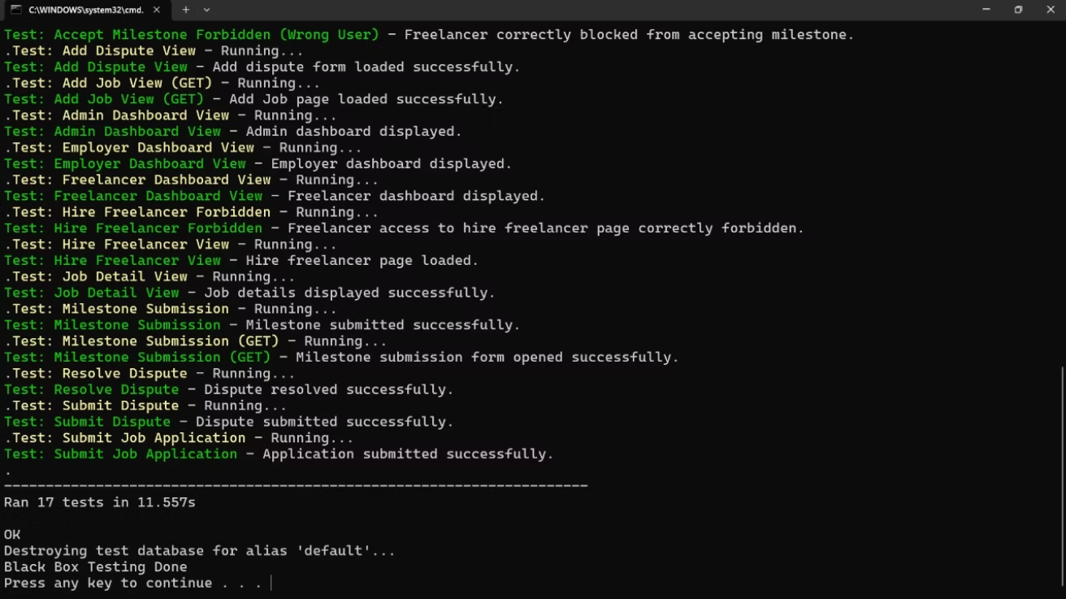
Unit Testing

Slide 26
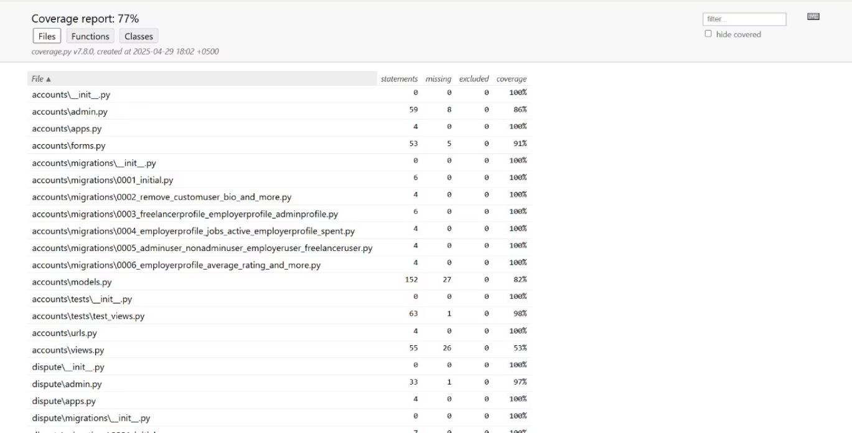
Coverage Report

Slide 27
Work Division Between Group Members
Name
Roll No
Responsibilities
Muhammad Bilal Khawar
22i-0786
Frontend UI (Jobs, Messaging, Profile), Documentation
Saffi M. Hashir
22i-1293
Backend APIs (Auth, Admin Panel, Jobs, Messaging), Database Management, Deployment
Hamza Ahmed Siddiqui
22i-1339
Frontend (Home, Projects, Payment, Analytics), Backend (Payments, Disputes)

Slide 28
Further Improvements
Advanced Payments
Video Calls
Integrate multiple payment gateways like PayPal and Stripe to offer users more flexible international payment and withdrawal options.
Add in-app video or voice call functionality to improve real-time communication between freelancers and employers beyond just chat messaging.
1
2
3
4
Recommendation Engine
AI Dispute Triage
Implement smart job recommendations for freelancers based on their skills, past projects, and application history using basic machine learning models.
Build an AI-based preliminary dispute analysis system to suggest automatic solutions for common issues, helping admins resolve disputes faster.

Slide 29
Lesson Learned
Full-stack Development
Agile Practices
Software Testing
Handled both frontend and backend effectively
Adopted sprints and iterative development
Applied black box and boundary value techniques
Deployment Challenges
Collaboration Tools
Deployed on Vercel, and Neon platforms
Used GitHub and Trello for seamless teamwork

Slide 30
Thank You for you time!
We appreciate your attention and welcome your questions.

